Slide 1
Real-Time Electricity Data
Team 2064

Slide 2
Task Overview
Find real-time data sources
Alberta Electric System Operator
IESO-Ontario
Nova Scotia Power
Fetch real-time data from sources
Develop a web page to show the data

Slide 3
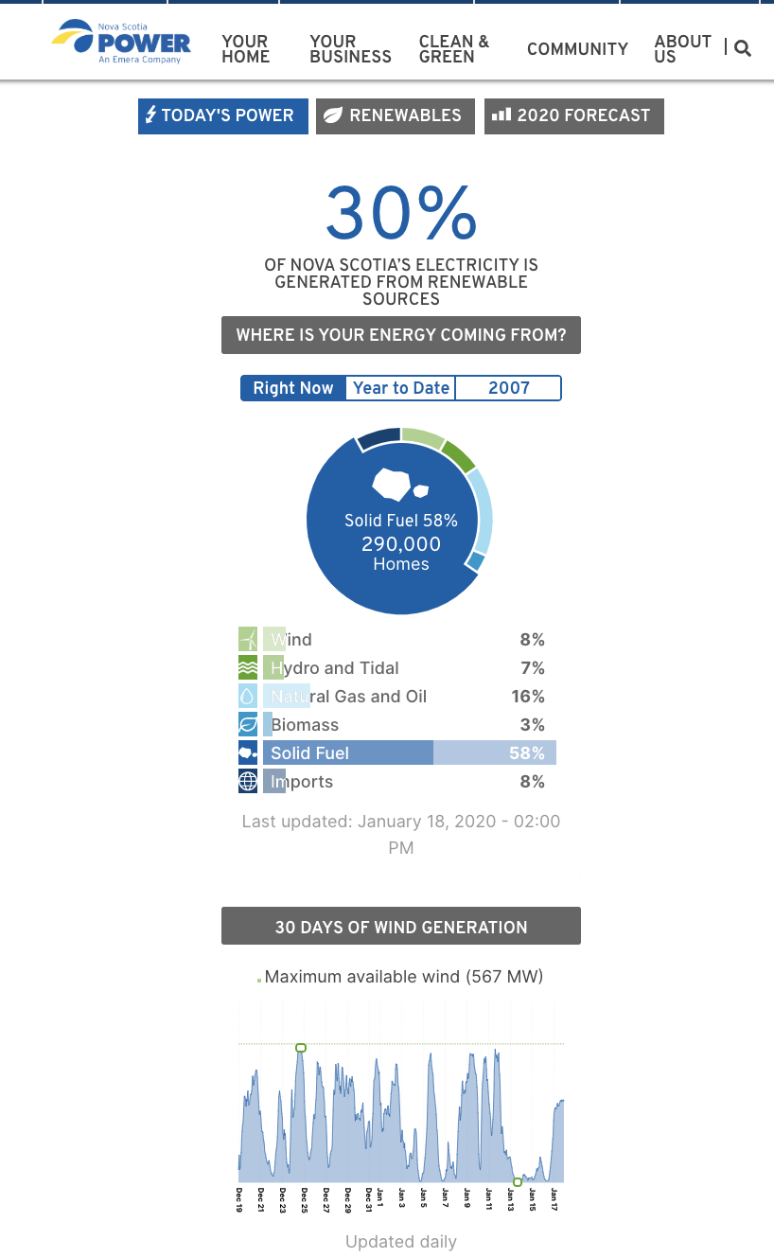
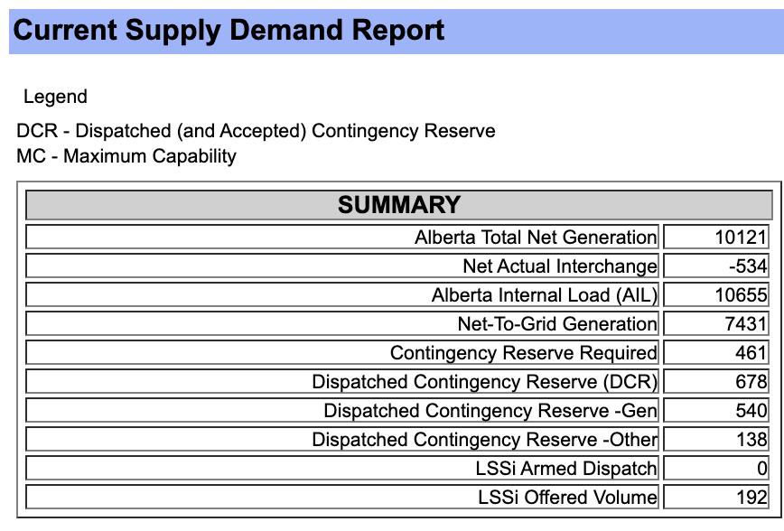
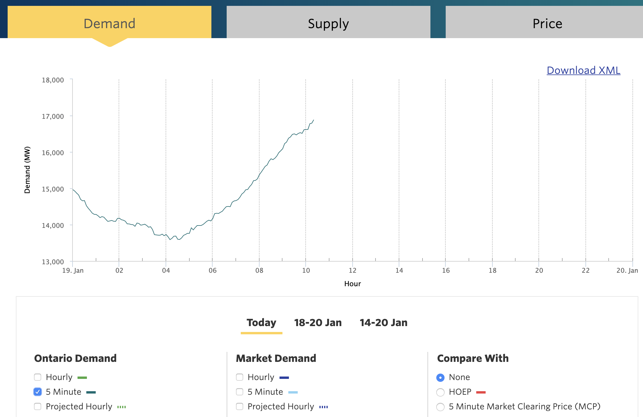
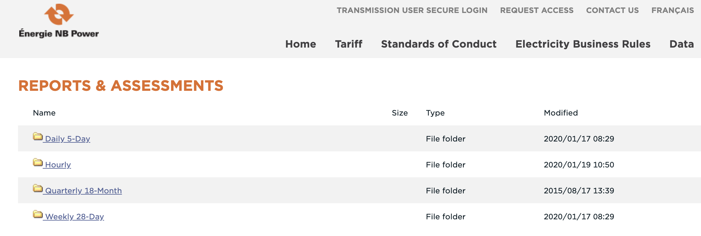
Find real-time data sources
All real-time source we found
Alberta: 1 min
Ontario: 5 mins
Nova Scotia: Hourly
New-Brunswick: Hourly

Slide 4
Software Architecture
Alberta
Fetching every 30sec
Real-time data
In format:
”Province”
“Time (Latest)”
“Demand”
“Supply”
Web App
Ontario
Fetching every 60sec
New Scotia
Fetching every 600sec
New-Brunswick
Fetching every 600sec

Slide 5
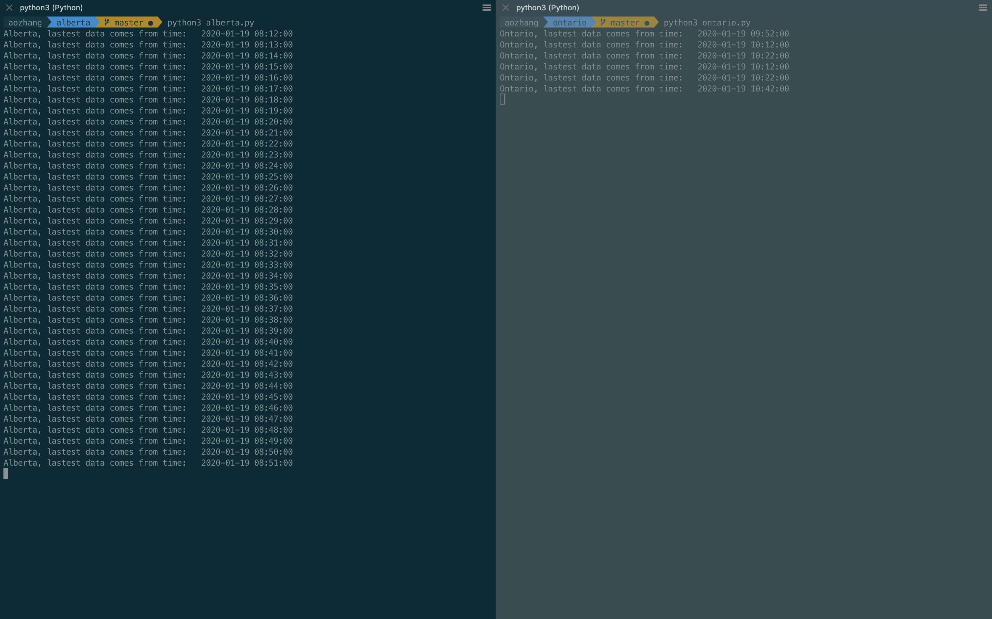
Debugging
Each province’s data is scrapped by separate threads.

Slide 6
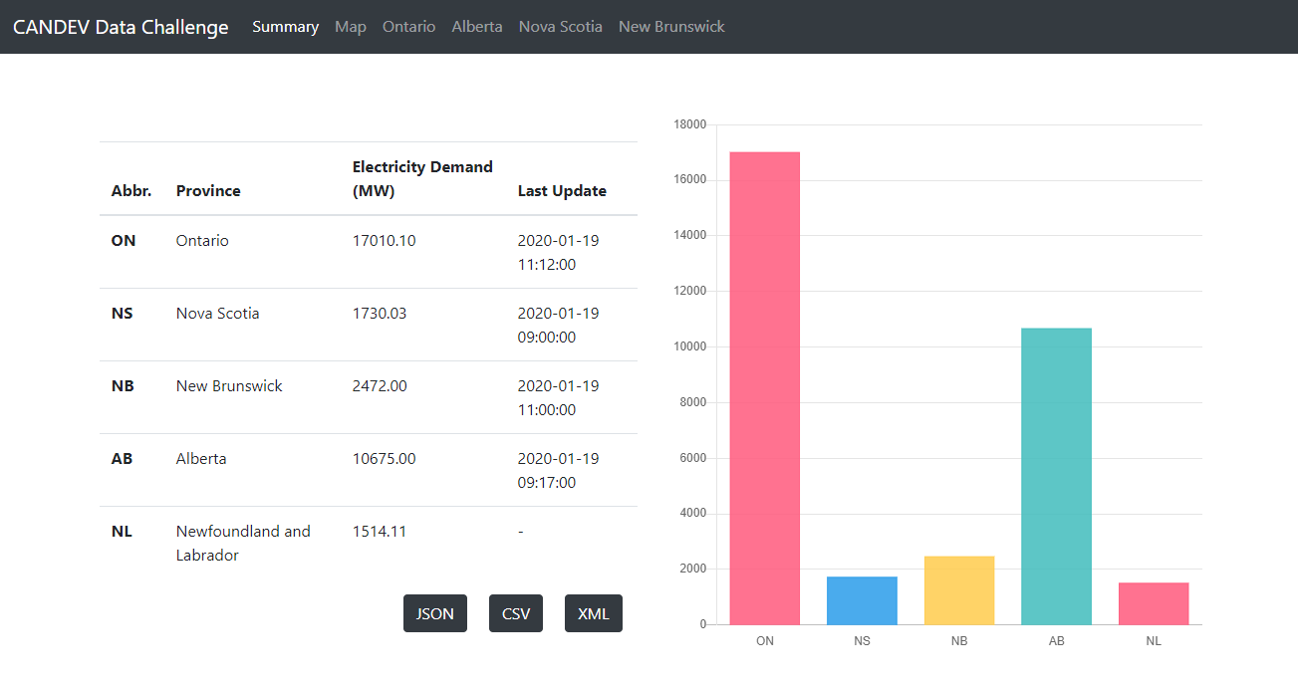
UI: Summary

Slide 7
UI: Maps

Slide 8
UI: Historical Data

